Slide 1
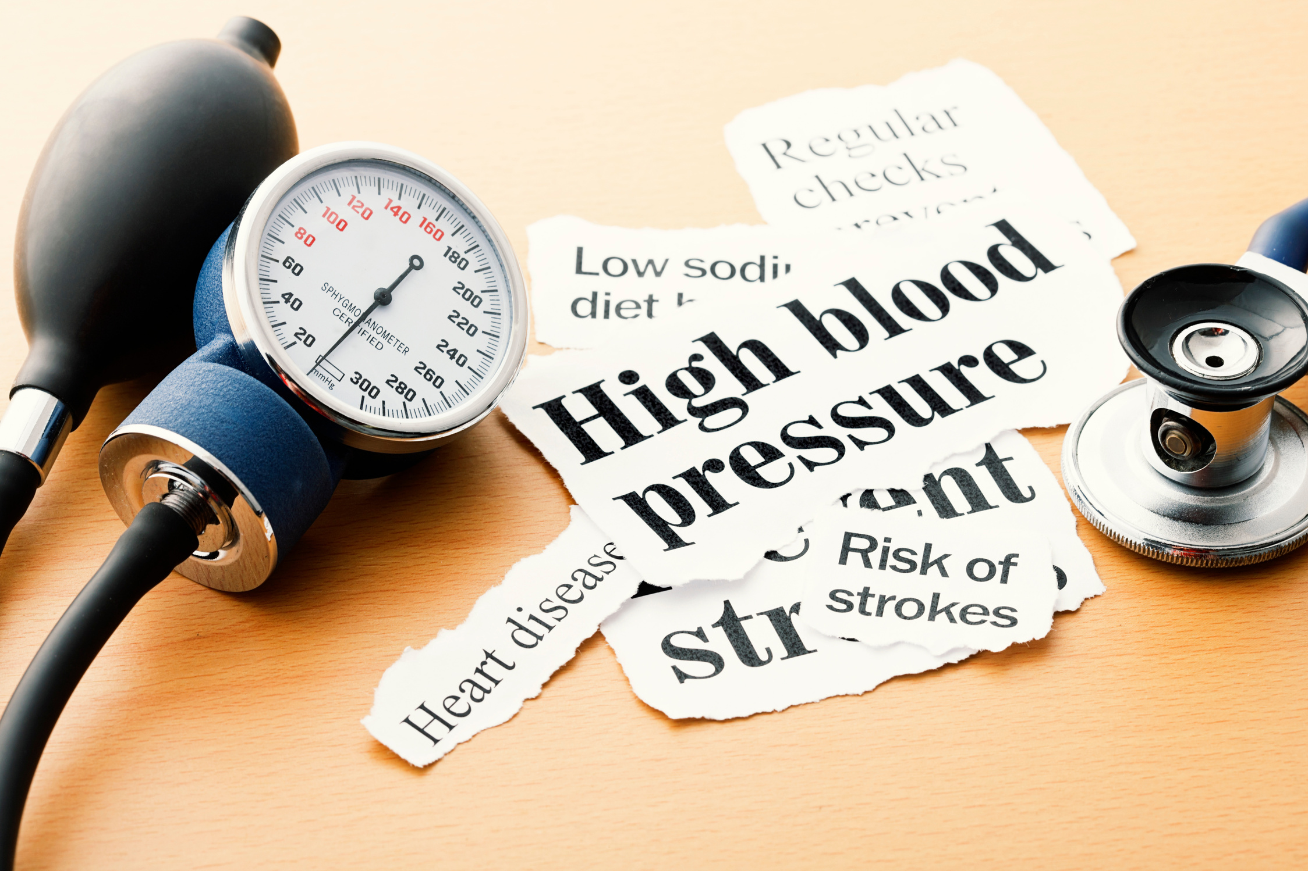
HYPERTENSION
DATA ANALYSIS PROJECT
USING SQL, EXCEL, AND POWER BI
by Neha S Soni
01

Slide 2
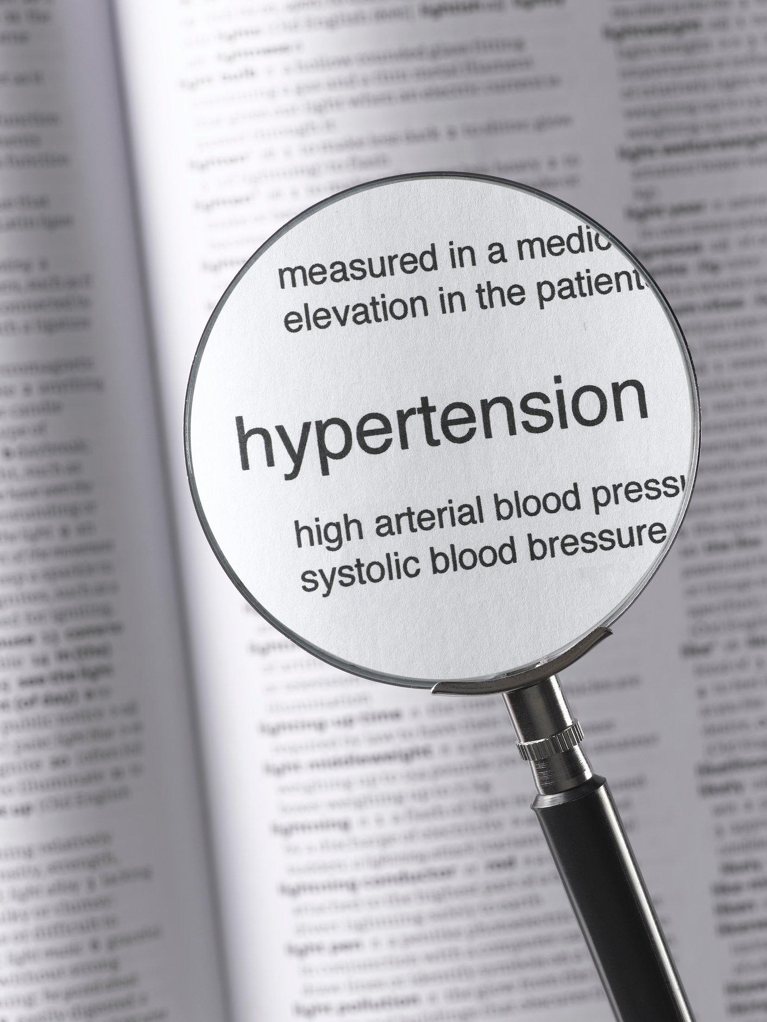

Problem Statement
Hypertension is a major health issue, and managing patient data effectively is crucial for better healthcare decisions.
This project aims to clean, analyze, and visualize hypertension data using SQL, Excel, and Power BI.
The dataset includes key variables like patient demographics, disease stage, bed occupancy, billing, and insurance.
02

Slide 3
Tools used
ChatGPT
Assisted in generating, cleaning, and analyzing datasets.
Provides support in understanding and automating SQL queries and reporting processes.
Microsoft Excel
Utilized for initial data entry and storage.
Facilitates quick data review and minor calculations.
MySQL
Used for data cleaning and querying.
Helps in filtering, sorting, and organizing the hypertension dataset efficiently.
Power BI
Creates interactive visualizations for deeper analysis of the dataset.
Enables exploration of trends, patterns, and outliers in the data.
Microsoft PowerPoint
Used for preparing the final project presentation.
Organizes the results and insights in a clear, visual format for stakeholders.
03

Slide 4

Data Collection and Cleaning
Data Collection:
The dataset was generated using ChatGPT with well-curated prompts to simulate a realistic hypertension dataset.
It includes patient demographics, disease stages, bed occupancy, billing, and insurance details.
Data Cleaning using Excel:
Excel was used to remove duplicate entries and rows with null values.
SQL queries further cleaned the data by:
Removing entries where discharge date was earlier than admit date.
Eliminating rows with missing billing amounts or patient IDs.
04

Slide 5
Data Insights from SQL Queries
Age Group and Gender Distribution:
Patients were grouped by age and gender, revealing a higher prevalence of hypertension in older males.
Billing Covered by Health Insurance:
A significant portion of total billing was covered by insurance, with gaps in later stages of hypertension.
Emergency Cases and Average Length of Stay:
Emergency cases had longer stays, contributing to higher billing.
Patient Count by Disease Status:
Most patients were in Stage 1 and Stage 2, with fewer emergency cases.
Unpaid Billing:
High unpaid amounts were noted when insurance didn’t fully cover the bill, especially in ICU cases.
ICU Occupancy Rates:
ICU occupancy was highest for advanced hypertension patients, indicating resource demand
05

Slide 6
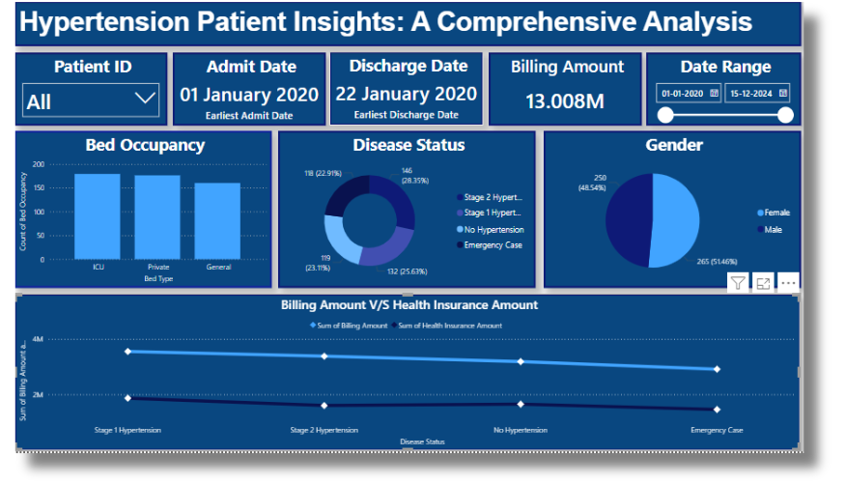
Power BI Visualizations
Age and Gender Distribution:
Visualizes the spread of hypertension across different demographics.
Hypertension Status:
Breakdown of disease severity in the population.
Bed Occupancy & Billing:
Analysis of billing amounts based on the type of bed (ICU, General, Private).
Insurance Coverage:
Comparison of total billing vs. insurance coverage for patients.
06

Slide 7

Conclusion
The analysis of hypertension data revealed critical insights into patient demographics, billing patterns, and resource utilization.
Stage 2 hypertension and emergency cases led to higher ICU occupancy and longer hospital stays, driving up costs.
Hypertension is prevalent among older age groups, particularly males.
Higher hypertension stages are associated with increased hospital bills and prolonged stays.
07

Slide 8

Result Analysis
Result Analysis:
SQL was essential for data cleaning and querying, ensuring accuracy. Excel allowed easy data management, while Power BI provided powerful visualizations for deeper insights. Together, these tools made it possible to identify trends and areas for resource optimization.
Benefits of Using Data Analytics:
Data analytics in healthcare helps streamline patient management, improve decision-making, and reduce operational costs.
It ensures better resource allocation and can help predict future healthcare needs, benefiting hospitals, insurance providers, and patients.
08

Slide 9
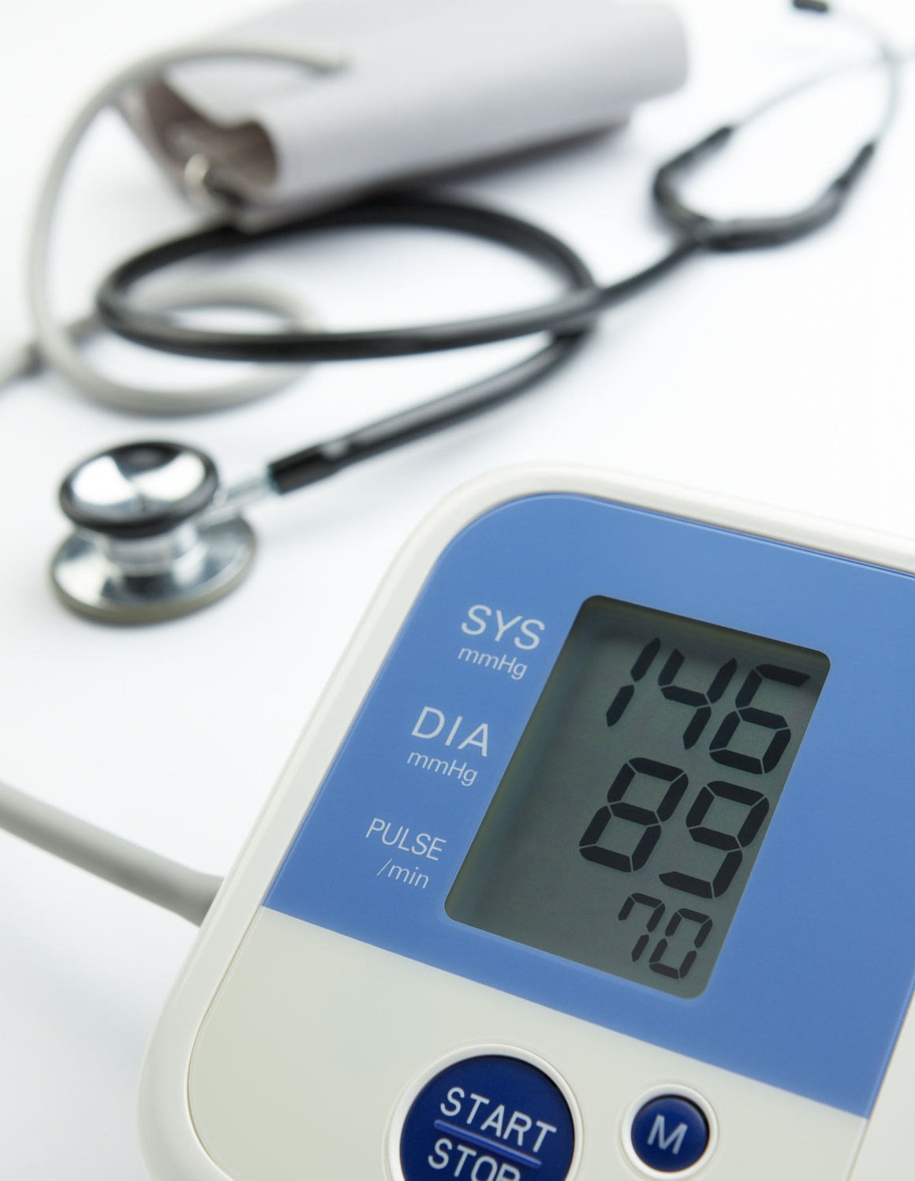
Future Recommendations
Implementing predictive analysis could help forecast future hypertension cases based on patient demographics, disease stages, and hospital stay data.
Predictive models can assist hospitals in anticipating ICU and resource demands, ensuring better preparedness and optimized care.
This analysis can also help insurance providers better assess potential costs for high-risk patients and adjust coverage accordingly.
09

